Slide 1
Training Data Reconstruction Attack
Amit Kravchik – amitkra@post.bgu.ac.il
Dr. Yisroel Mirsky – yisroel@post.bgu.ac.il

Slide 2
Sketch of the technique
Objective: to identify data samples which are outliers on boundaries
Hypothesis: samples on boundaries cause distortions in the boundary between classes. Even single support samples can cause these distortions.
Method: Given a trained model, use a gradient-based technique to reconstruct a sample from the training data in three stages.
The stages are:
Find a decision boundary.
Traverse along the decision boundary to locate specific niches or anomalies.
Assess whether the perturbed data sample is realistic and can be a part of the training data of this model. (This stage has not been explored yet.)

Slide 3
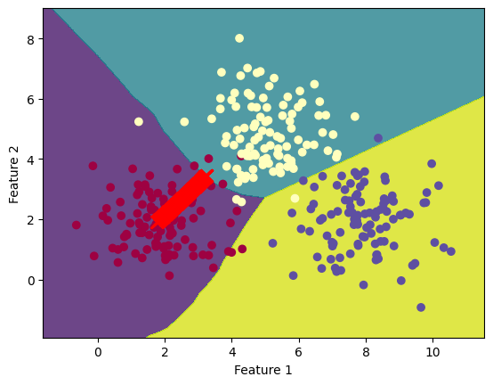
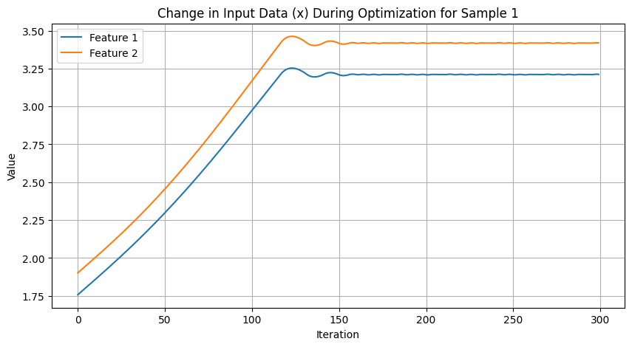
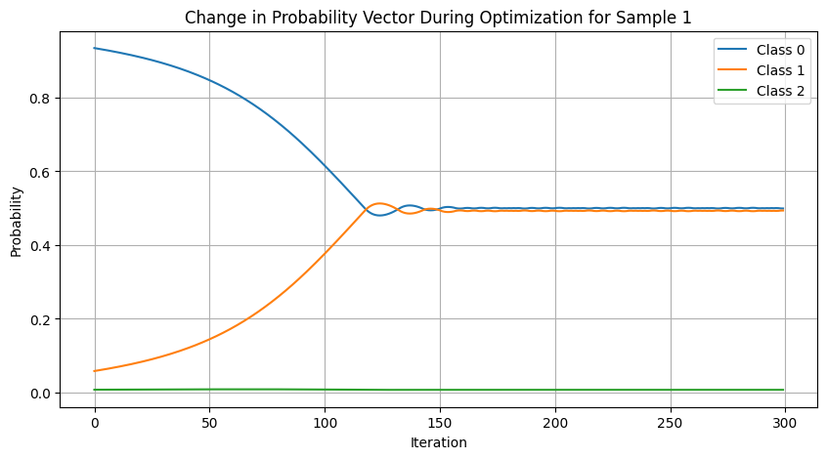

Stage 1: Identify the Decision Boundary
We use a loss function that we believe that can get us closer to the decision boundary:
$$L = | p − \frac{1}{b}|$$
Where $p$ is the probability of the class which the original (unperturbed) data was predicted to belong to, and $b$ is the number of classes that are separated by the boundary.
In the following example, b=2:
Visual Illustration of the Change in the Input Data During Optimization

Slide 4
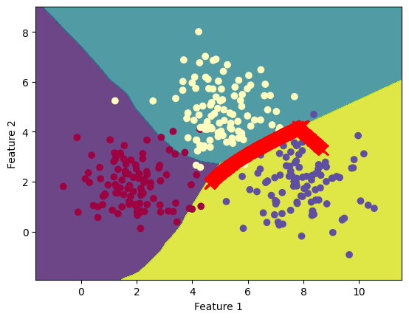
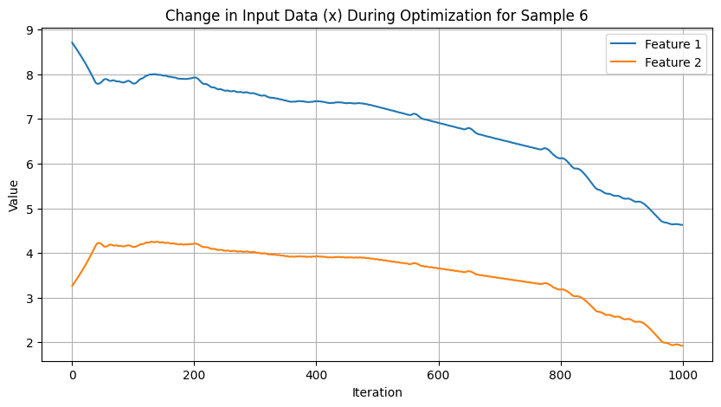
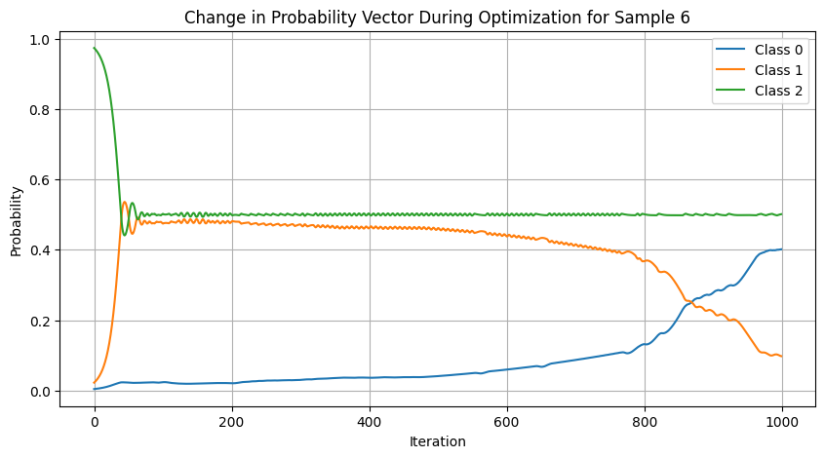

Stage 2: Traverse the Decision Boundary
After identifying the boundary – use weighted gradient direction update that combines the gradient’s orthogonal to make the data point progress along the boundary when reaching it.
$$weighted direction= α ∗gradient direction+\left(1−α\right)∗orthogonal direction$$
(If loss > 0.002 (tentative threshold), $α$ = 1
Else, $α$ = loss)
Visual Illustration of the Change in the Input Data During Optimization

Slide 5
Looking forward to hear your thoughts!

Slide 6
